Slide 1
BIOMETRIC IDENTIFICATION USING DENTAL RADIOGRAPHS
Batch Memebers
1.Gowtham S Kirthik 712816104011
2.S.Karthik 712816104015
3.Sneha S 712816104036
Guided By,
Prof.R.Thenmalar M.E
Department of CSE

Slide 2
Objective
The primary objective of the project is
To predict teeth structure in Dental opg image.
Here we applying Deep Learning and Image processing for classification of features and comparison of images.

Slide 3
Problem Definition
In this project ,a model of teeth structure recognition has been proposed to identify a person. The person’s teeth image has been matched against the database of teeth images. To identify persons while in unprectable deaths and situations.

Slide 4
Existing System
The system using matlab for image processing through segmentation scheme’s
It uses machine learning algorithms such as
Support Vector Machine ,Random forest and
Bayesian classification schemes etc.,
Drawback:
Difficult to get accurate results.
Not applicable for multiple images for lesion segmented(abnormal marks) in a short time.
It requires more time.
less classification accuracy.

Slide 5
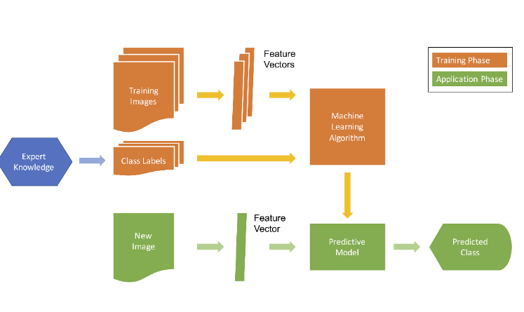
Existing System Architecture

Slide 6
Proposed System
The system using OpenCV for image acquisition.
It uses Deep learning methods such as
Convolution Neural Network for features
extraction and comparison.
Merits:
It achieve high-accuracy classification.
It also uses Max pooling technique for high accuracy.
Less time consuming.

Slide 7
Block Diagram
Database
Images
Pre- processing
Feature Selection
Feature Extraction
CNN
Classifier
Dental Radiographs
Pre- processing
Feature
Selection
(DWT)
Feature
Extraction
(GLCM)
Prediction

Slide 8
Convolutional Neural Networks

Slide 9
Modules
Training part
Features matching and classification
Testing

Slide 10
1.Training part
The preprocessing of image aims at selectively removing the redundancy present in captured images without affecting the details that play a key role in the overall process.
It mainly deals with datasets and training those image for furture process.

Slide 11
2.Features matching and classification
The input is converter for Gray scale images.
DWT decomposes a sign into a set of sub-bands through consecutive excessive-bypass and coffee-pass filtering of the time domain.

Slide 12
3.Testing
In this phase image comparison will take place by using the GLCM(Grey-Level Co-Occurrence Matrix) and the prediction of the desired input image is done .

Slide 13
Application
Medical Application
Dental studies.
Forensic identification
Identify human in unpredictable deaths.
Biometrics Application

Slide 14
Software Requirement
Python 3.6.8 version
OpenCV
Tensorflow

Slide 15
SUMMARY
In this paper used to improve detection precisions, we propose three post-processing techniques to supplement the baseline faster CNN according to certain prior domain knowledge. Filtering algorithm is constructed to delete overlapping boxes detected by faster CNN associated with the same tooth. In this paper already defined for labels in teeth imageIn this proposed system for Deep learning method in convolution Neural Network (CNN) the Tensor Flow tool package to detect and number teeth in dental periapical films.

Slide 16
References
Yu-cheng Chen, Derek Jin-Ki Hong, Chia-Wei Wu, Muralidhar Mupparapu. The Use of Deep Convolutional Neural Network in Biomedical Imaging. Journal of Orofacial Sciences.(2019) .
Georges Dibeh, Alaa Hilal, Jamal Charara. A Noval Approach for Dental Panoramic Radiograph Segmentation. International Multidisciplinary Conference on Engineering Technology.(2018).
Karunya, Askarunisa, Athiraja. Human Identification Using Dental Biometrics.International Journal of Applied Engineering Research.(2014).
Nomir O, Abdel-Mottaleb M. Human Identification From Dental X-Ray Images Based on the Shape and Appearance of the Teeth. IEEE Transactions on Information Forensics and Security. 2007;2:188– 197. doi: 10.1109/TIFS.2007.897245. [CrossRef] [Google Scholar]
Zhou J, Abdel-Mottaleb M. A content-based system for human identification based on bitewing dental X-ray images. Pattern Recognition. 2005;38:2132–2142. doi: 10.1016/j.patcog.2005.01.011. [CrossRef] [Google Scholar]

Slide 17


